Slide 1
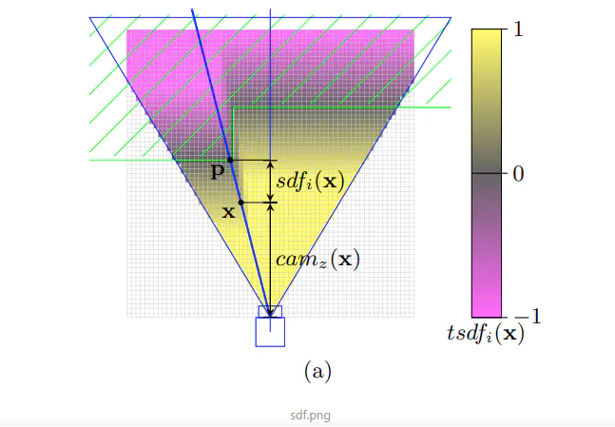
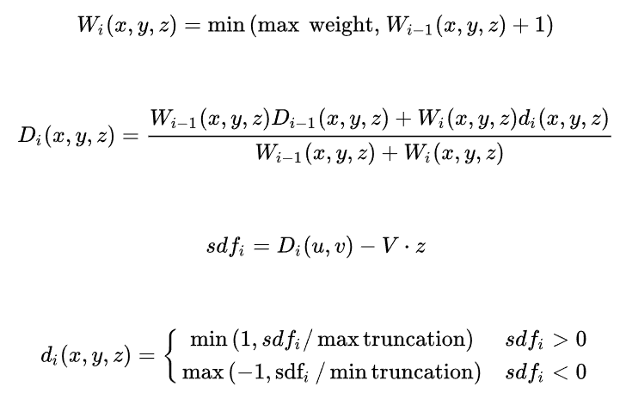
TSDF：Truncated Signed Distance Function
对于每帧图像，将体素坐标映射到图像坐标，同图像深度值比较，进而更新体素中的sdf和权重信息
更新足够多帧之后，选取sdf足够小且权重足够大的体素作为空间点云
通过这些空间点云生成mesh/surface信息
TSDF 是截断的SDF
为何用体素而不是直接的像素+深度作为点云呢？
每个像素对应的真实空间大小不一致

Slide 2
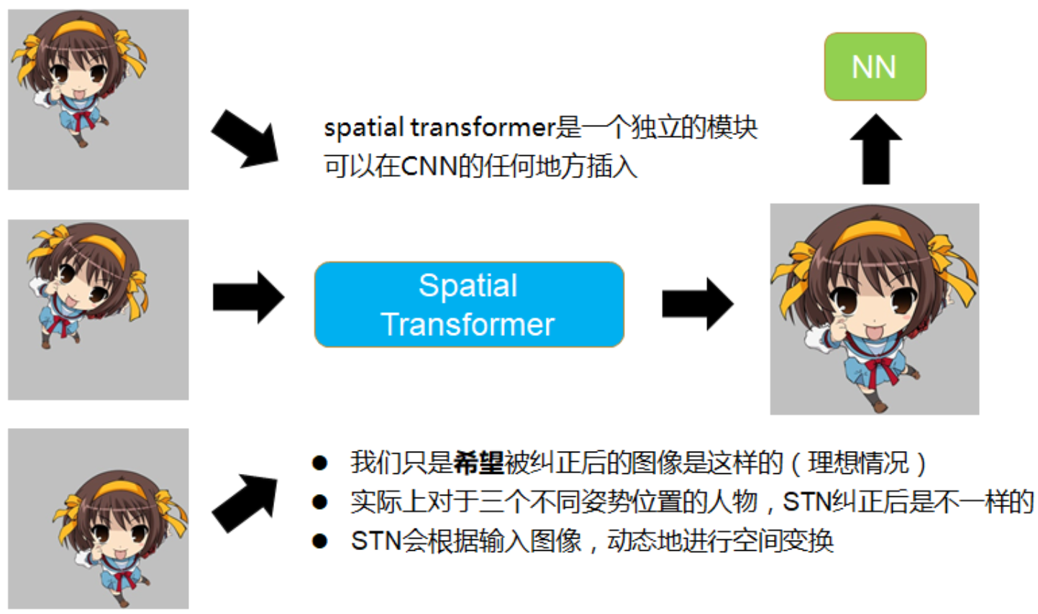
STN：Spatial Transformer Networks 空间变换网络
对输入Feature map（包括输入图像）进行空间变换，纠正位置、旋转、大小，满足CNN网络输入需求

Slide 3
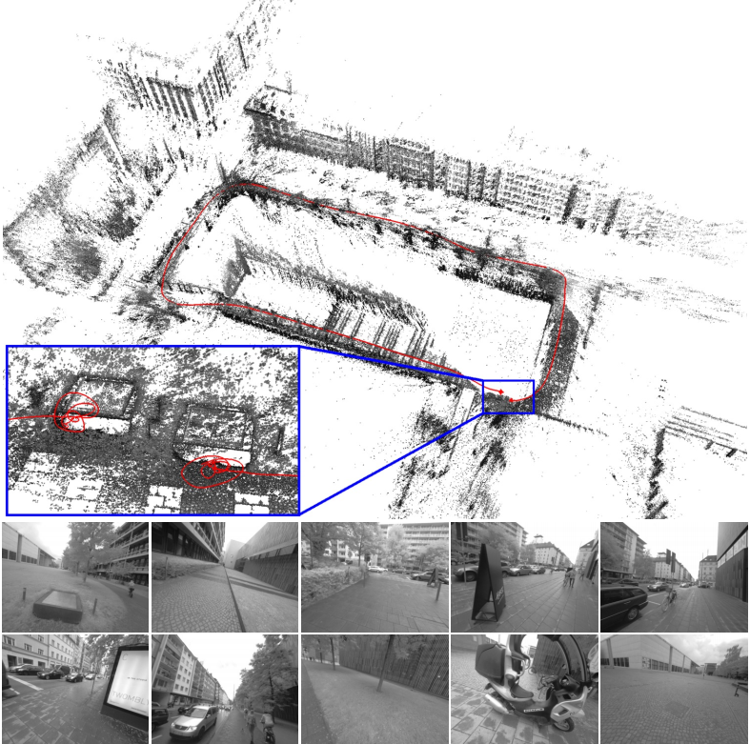
DSO（Direct Sparse Odometry）
特征点法最小化重投影误差，直接法最小化光度误差
特征点法匹配、位置估计分步进行，相互优化。直接法将数据关联和位姿估计放在一起
DSO提出光度标定来减少光照变化带来的影响，使用相机曝光时间、暗角、gamma响应等标定值进行校准，也具备自标定功能
DSO保留一个5~7关键帧的活动窗口进行后端优化
不包含回环检测、地图复用
环境光源带来的影响无法回避

Slide 4
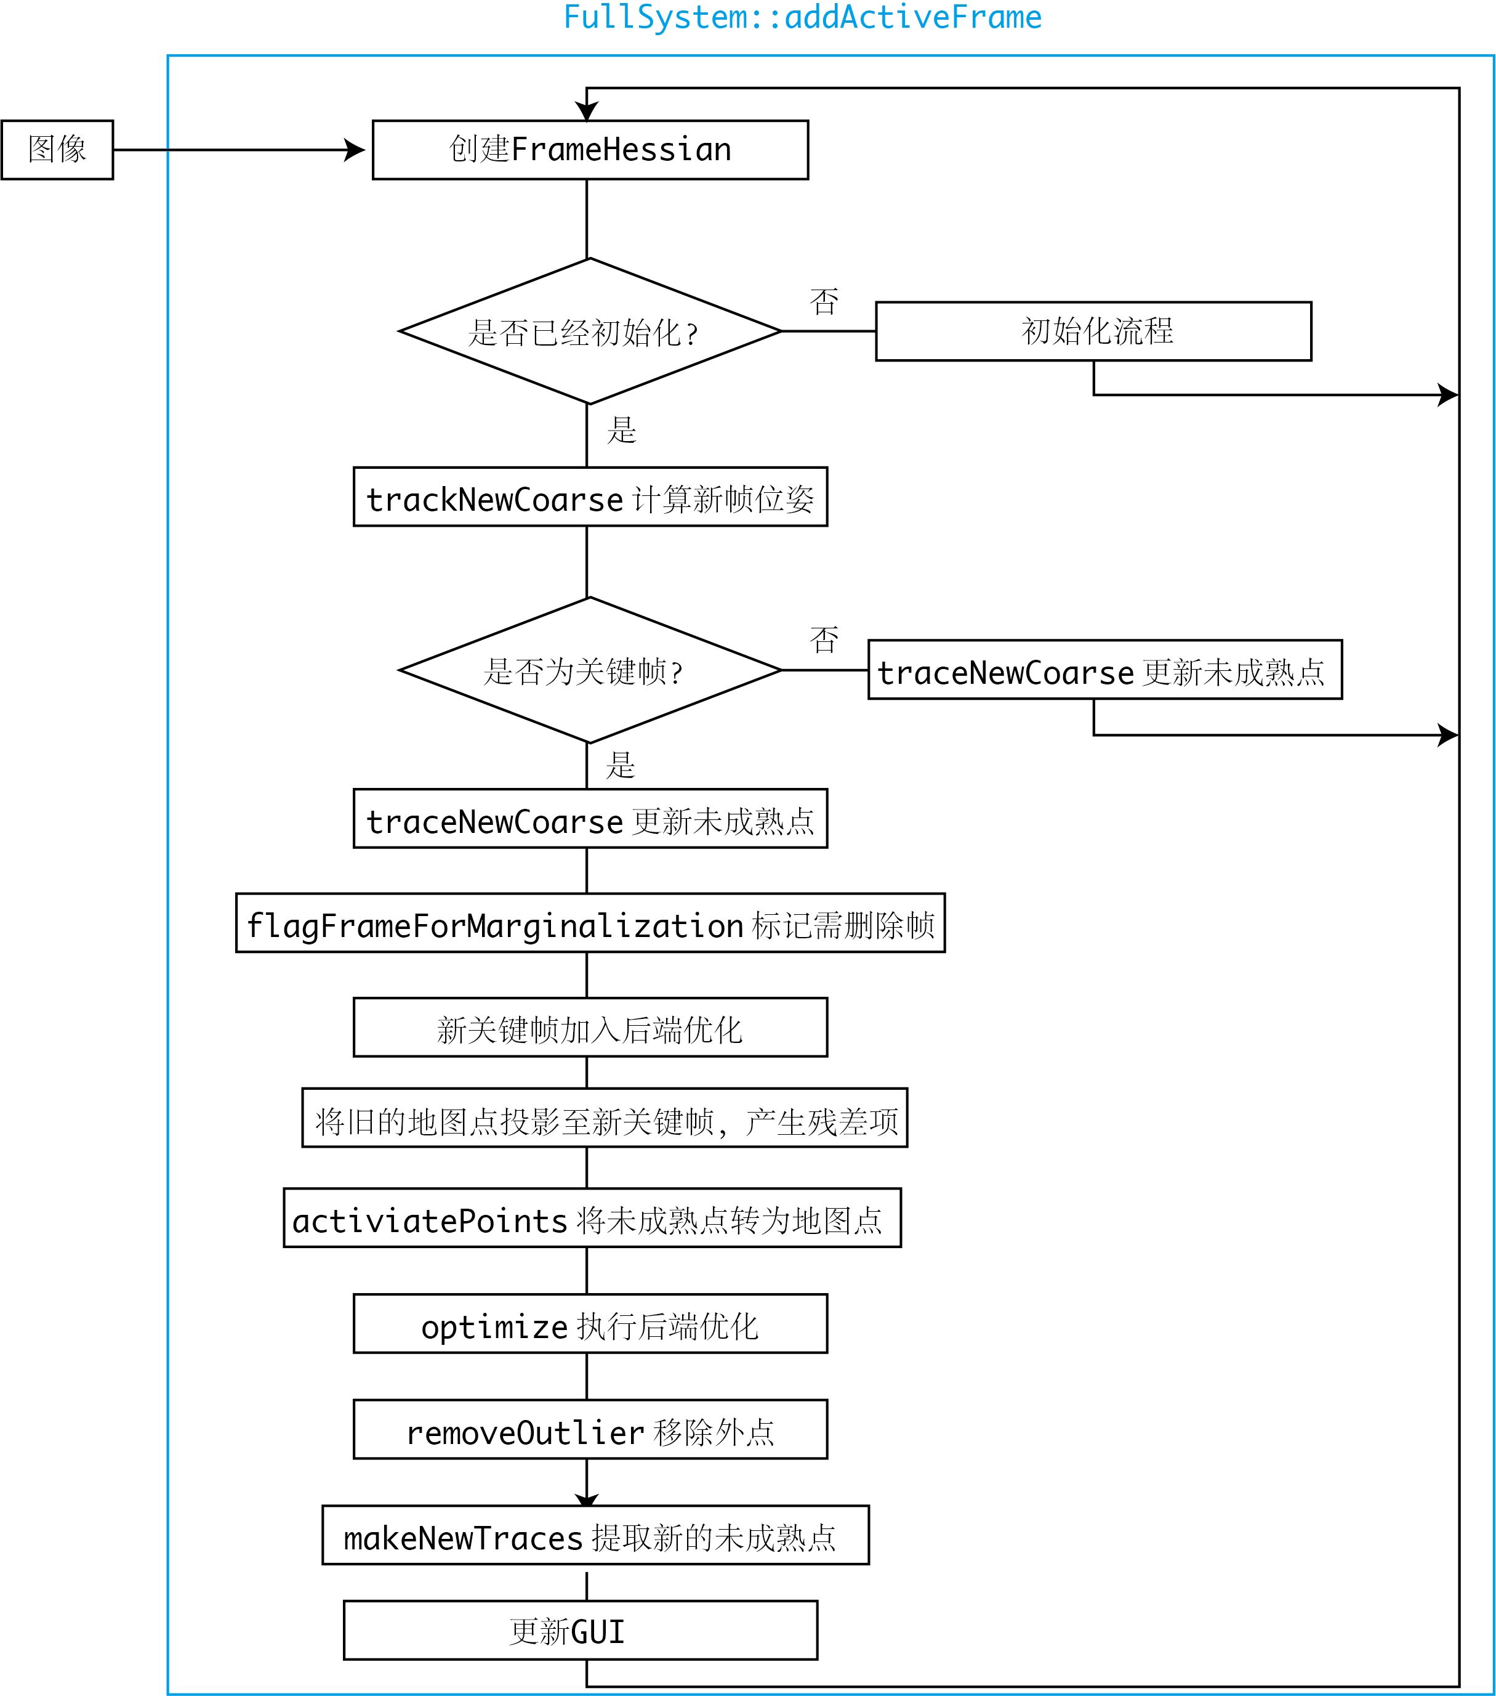
DSO（Direct Sparse Odometry）流程
对于非关键帧，DSO仅计算它的位姿，并用该帧图像更新每个未成熟点的深度估计；
后端仅处理关键帧部分的优化。除去一些内存维护操作，对每个关键帧主要做的处理有：增加新的残差项、去除错误的残差项、提取新未成熟点。
整个流程在一个线程内，但内部可能有多线程的操作。

Slide 5
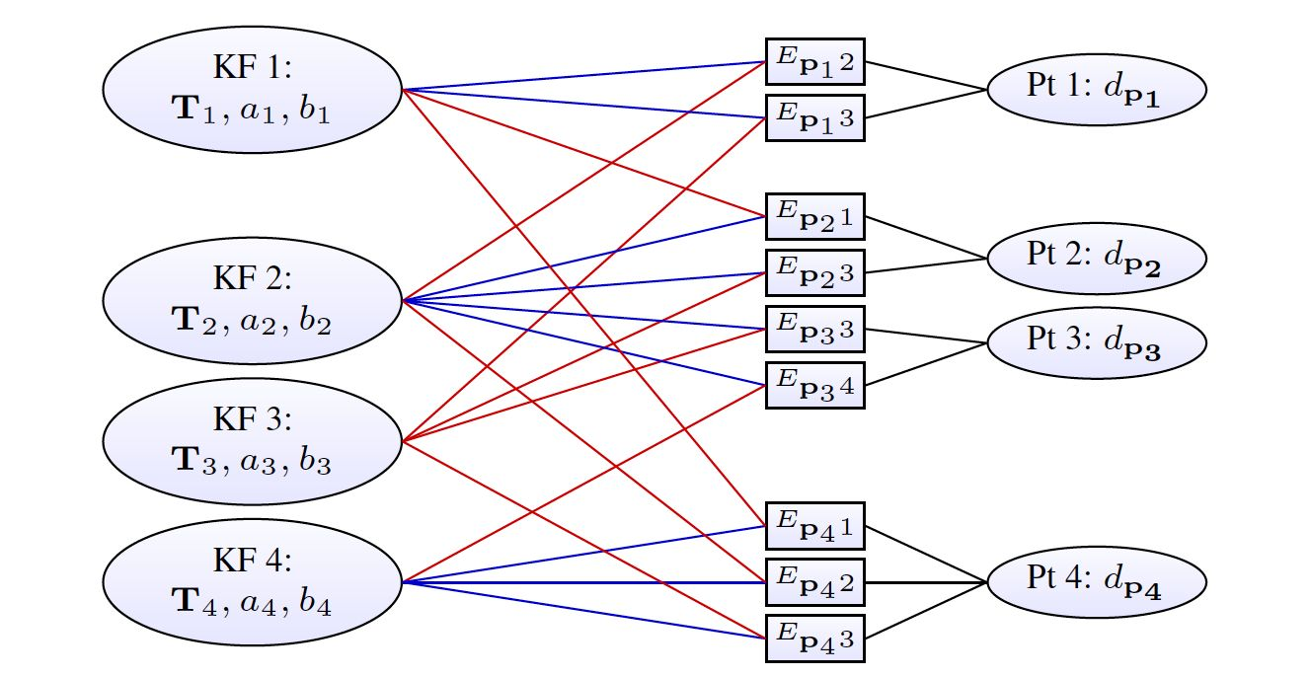
DSO（Direct Sparse Odometry）后端优化
这是个最小二乘问题
每个关键帧8维，地图点优化变量仅有逆深度
DSO的三个雅克比：
图像雅克比（I）
几何雅克比（T）
光度雅克比（a,b）

Slide 6
TANDEM
使用DSO的后端（关键帧窗口）优化，以及稠密深度图辅助的前端
稠密深度图通过CVA-MVSNet生成，基于MVSNet，通过Cascade Cost Volume优化了内存占用
基于关键帧关联性权重非随机，对Cost Volume中Cost计算增加了帧权重优化

Slide 8
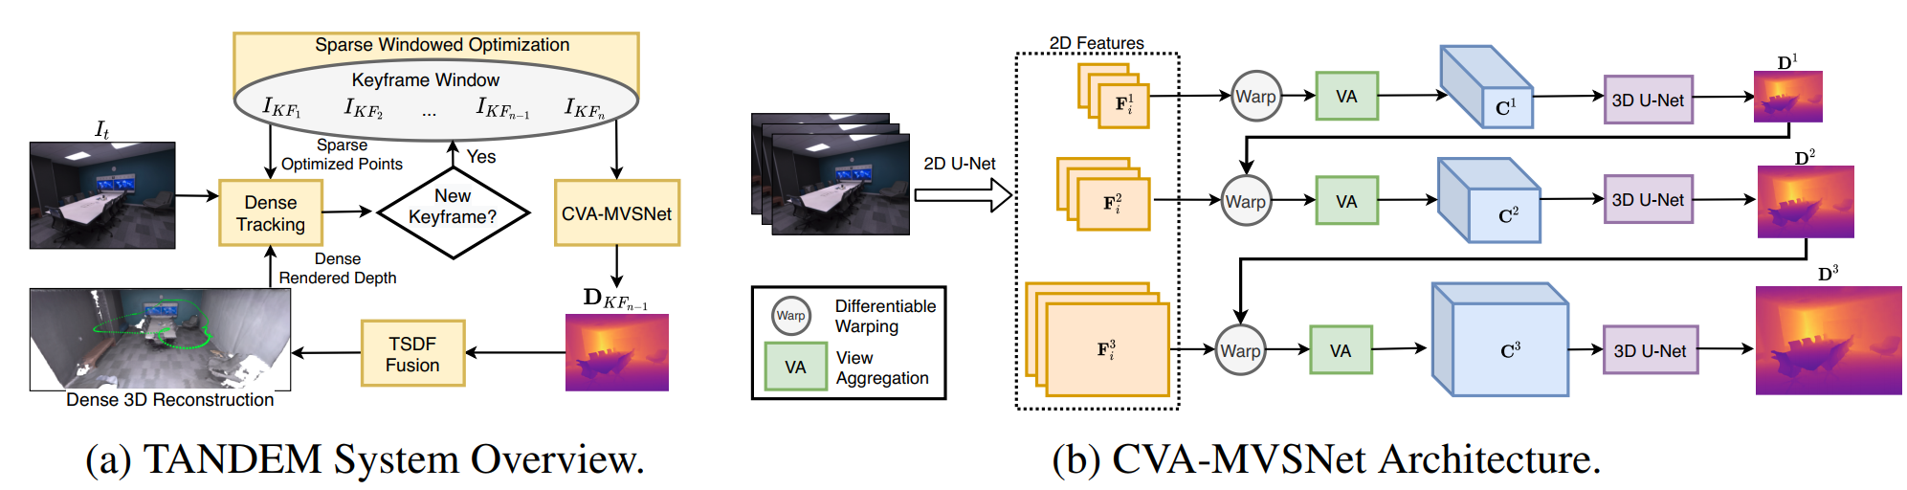
TANDEM

Slide 9
TANDEM

Slide 11

工作总结
20XX
工作概述/企业介绍/商务策划书
Theme color makes PPT more convenient to change.Adjust the spacing to adapt to Chinese typesetting

Slide 12

CONTENTS
01
工作概述
完成情况
02
Theme color makes PPT more convenient to change.
Adjust the spacing to adapt to Chinese typesetting, use the reference line in PPT.
Theme color makes PPT more convenient to change.
Adjust the spacing to adapt to Chinese typesetting, use the reference line in PPT.
03
不足之处
工作计划
04
Theme color makes PPT more convenient to change.
Adjust the spacing to adapt to Chinese typesetting, use the reference line in PPT.
Theme color makes PPT more convenient to change.
Adjust the spacing to adapt to Chinese typesetting, use the reference line in PPT.

Slide 13
https://www.ypppt.com/
FASHION
0 1
PART.
工作概述
Theme color makes PPT more convenient to change.
Adjust the spacing to adapt to Chinese typesetting, use the reference line in PPT.

Slide 14

单击添加标题
Theme color makes PPT more convenient to change.
Adjust the spacing to adapt to Chinese typesetting, use the reference line in PPT.
添加标题
添加标题
Copy paste fonts. Choose the only option to retain text.
……
Copy paste fonts. Choose the only option to retain text.
……

Slide 15
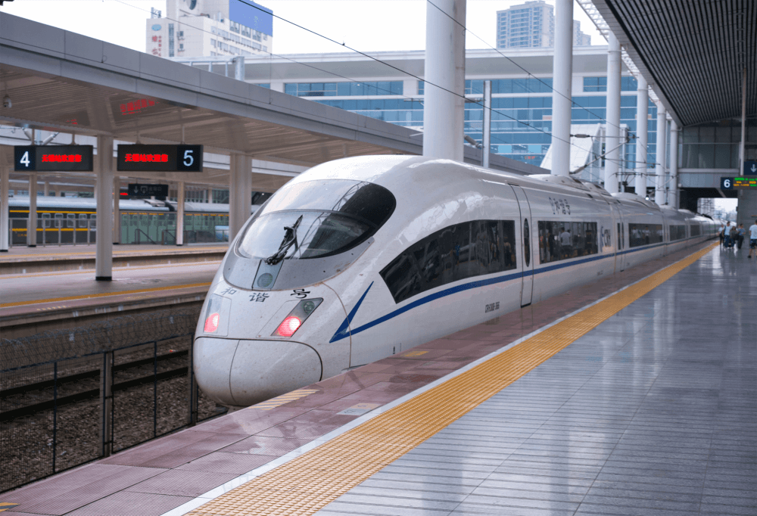
单击添加标题
Unified fonts make reading more fluent.
Theme color makes PPT more convenient to change.
Adjust the spacing to adapt to Chinese typesetting, use the reference line in PPT.
01.添加标题
02.添加标题
Copy paste fonts. Choose the only option to retain text.
……
Copy paste fonts. Choose the only option to retain text.
……

Slide 16
单击添加标题
添加标题
1
2
添加标题
Copy paste fonts. Choose the only option to retain text.
… …
Copy paste fonts. Choose the only option to retain text.
… …

Slide 17

单击添加标题
添加标题
Copy paste fonts. Choose the only option to retain text.
…text
添加标题
Copy paste fonts. Choose the only option to retain text.
添加标题
Copy paste fonts. Choose the only option to retain text.

Slide 18
FASHION
0
2
PART.
完成情况
Theme color makes PPT more convenient to change.
Adjust the spacing to adapt to Chinese typesetting, use the reference line in PPT.

Slide 19
单击添加标题
添加标题
添加标题
添加标题
Copy paste fonts. Choose the only option to retain text.
Copy paste fonts. Choose the only option to retain text.
添加标题
添加标题
添加标题
添加标题
添加标题
Copy paste fonts. Choose the only option to retain text.
Copy paste fonts. Choose the only option to retain text.

Slide 20

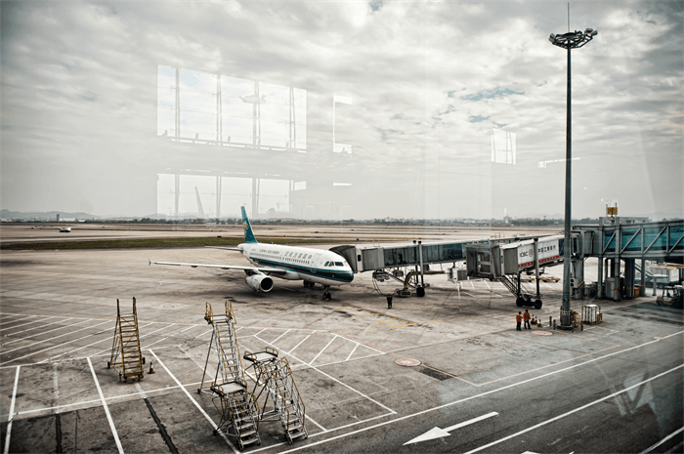
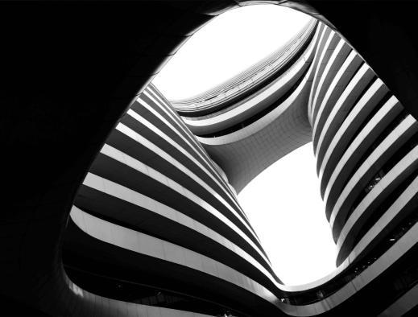
单击添加标题
添加标题
添加标题
添加标题
Copy paste fonts. Choose the only option to retain text.
……
Copy paste fonts. Choose the only option to retain text.
……
Copy paste fonts. Choose the only option to retain text.
……
PPT模板 http://www.1ppt.com/moban/

Slide 21


单击添加标题
添加标题
添加标题
Copy paste fonts. Choose the only option to retain text.
……
添加标题
Copy paste fonts. Choose the only option to retain text.
……
Copy paste fonts. Choose the only option to retain text.
……

Slide 22

单击添加标题
添加标题
Copy paste fonts. Choose the only option to retain text.
……
添加标题
…text
Copy paste fonts. Choose the only option to retain text.
……
添加标题
Copy paste fonts. Choose the only option to retain text.
……
Copy paste fonts. Choose the only option to retain text.
……

Slide 23
FASHION
0
3
PART.
不足之处
Theme color makes PPT more convenient to change.
Adjust the spacing to adapt to Chinese typesetting, use the reference line in PPT.
Notes:
https://www.ypppt.com/

Slide 24

单击添加标题
添加标题
添加标题
添加标题
Copy paste fonts. Choose the only option to retain text.
……
Copy paste fonts. Choose the only option to retain text.
……
Copy paste fonts. Choose the only option to retain text.
……

Slide 25

单击添加标题
01.添加标题
02.添加标题
03.添加标题
Copy paste fonts. Choose the only option to retain text.
……
Copy paste fonts. Choose the only option to retain text.
……
Copy paste fonts. Choose the only option to retain text.
……

Slide 26
单击添加标题
单击添加标题
单击添加标题
Unified fonts make
reading more fluent.
单击添加标题
单击添加标题
单击添加标题
单击添加标题

Slide 27




单击添加标题
添加标题
添加标题
添加标题
添加标题
Copy paste fonts. Choose the only option to retain text.
… …
…
Copy paste fonts. Choose the only option to retain text.
… …
…
Copy paste fonts. Choose the only option to retain text.
… …
…
Copy paste fonts. Choose the only option to retain text.
… …
…

Slide 28
单击添加标题
Copy paste fonts. Choose the only option to retain text.
……
Copy paste fonts. Choose the only option to retain text.
……
Copy paste fonts. Choose the only option to retain text.
……
Copy paste fonts. Choose the only option to retain text.
……
Copy paste fonts. Choose the only option to retain text.
……
Copy paste fonts. Choose the only option to retain text.
……
… | 30%
… | 60%
… | 10%

Slide 29

Unified fonts make reading more fluent.
01.Text
02.Text
03.Text
Copy paste fonts. Choose the only option to retain text.
……
……
Copy paste fonts. Choose the only option to retain text.
……
……
Copy paste fonts. Choose the only option to retain text.
……
……

Slide 30
FASHION
0
4
PART.
工作计划
Theme color makes PPT more convenient to change.
Adjust the spacing to adapt to Chinese typesetting, use the reference line in PPT.

Slide 31


添加标题
单击添加标题
Copy paste fonts. Choose the only option to retain text.
……
Theme color makes PPT more convenient to change.
Adjust the spacing to adapt to Chinese typesetting, use the reference line in PPT
添加标题
Copy paste fonts. Choose the only option to retain text.
……
…Text
…Text
…Text
…Text
…Text

Slide 32
单击添加标题
添加标题
添加标题
添加标题
Supporting text here.
Copy paste fonts. Choose the only option to retain text.
… …
Supporting text here.
Copy paste fonts. Choose the only option to retain text.
… …
Supporting text here.
Copy paste fonts. Choose the only option to retain text.
… …

Slide 33

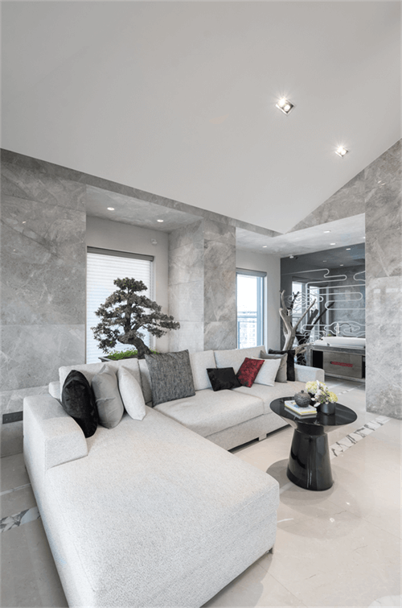
单击添加标题
添加标题
Copy paste fonts. Choose the only option to retain text.
……
添加标题
Copy paste fonts. Choose the only option to retain text.
……
Copy paste fonts. Choose the only option to retain text.
……
Copy paste fonts. Choose the only option to retain text.
……
Copy paste fonts. Choose the only option to retain text.
……
Copy paste fonts. Choose the only option to retain text.
……

Slide 34
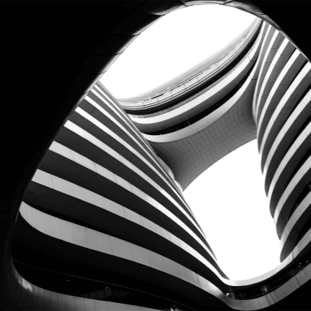
单击添加标题
添加标题
添加标题
Copy paste fonts. Choose the only option to retain text……
Copy paste fonts. Choose the only option to retain text……
添加标题
添加标题
Copy paste fonts. Choose the only option to retain text……
Copy paste fonts. Choose the only option to retain text……

Slide 35
谢谢大家
20XX
工作概述/企业介绍/商务策划书
Theme color makes PPT more convenient to change.Adjust the spacing to adapt to Chinese typesetting

Slide 36
更多精品PPT资源尽在—优品PPT！
www.ypppt.com
PPT模板下载：www.ypppt.com/moban/ 节日PPT模板：www.ypppt.com/jieri/
PPT背景图片：www.ypppt.com/beijing/ PPT图表下载：www.ypppt.com/tubiao/
PPT素材下载： www.ypppt.com/sucai/ PPT教程下载：www.ypppt.com/jiaocheng/
字体下载：www.ypppt.com/ziti/ 绘本故事PPT：www.ypppt.com/gushi/
PPT课件：www.ypppt.com/kejian/
Notes:
模板来自于 优品PPT https://www.ypppt.com/

